Slide 1
Office of foundation relations

Slide 2
BIG SWING
How to make your research program attractive to donors and cultivate funding relationships
Notes:
Thank you to the ASPIRE Center for inviting us to speak. This is the second of two training sessions on strategies for adding private funding into your external fundraising portfolio. Materials from the first session are available on the OSU Foundation’s website.
My name is Elizabeth Ocampo. I’m one of the directors of development for the Office of Foundation Relations at the OSU Foundation. My colleague Emily and I are happy to be with you today. Very quickly, before we get into the meat of our presentation, Emily is going to introduce our team and the services of our office.

Slide 3
OSU Foundation Office of Foundation Relations
TBD
Senior Director
Paul DuBois
Director
Elizabeth Ocampo
Director
Emily J. Payne
Assistant Director
Adeline Hull
Coordinator
Notes:
OSU Foundation is a 501c3 organization, separate from the university, tasked with receiving and administering charitable contributions supporting OSU. Through OSU Foundation, the university has an easy avenue to receive contributions from donors -- individuals or organizations -- interested in a charitable tax deduction.
The OSU Foundation’s office of Foundation Relations is a four-person team, who each manage relationships with a portfolio of non-profits and private foundations. We support work across campus to develop and submit proposals to private foundations. The TBD Senior Director and works with university priority foundations like Murdock Charitable Trust and Keck Foundation. Paul DuBois is the Director of Development and works with a lot of health science and RFP-driven foundations. Elizabeth Ocampo is the other Director and works with social science and direct service grantmakers. Emily Payne is the Assistant Director and works with grants under $50,000. Supporting our workflow is Adeline “Addie” Hull as our Coordinator. She’s a great starting point if you don’t know who to reach on the team.

Slide 4
Foundation Relations Services
The OSU Foundation Office of Foundation Relations is here to help get you funding.
Prospect research, vetting
Relationship development with private foundations
Proposal review, editing, and submission
Post-award report coordination and submission
Grant writing and proposal development training

Slide 5
AGENDA
Informal pathways to donors
What is most attractive about your research?
How OSU Foundation can help
Update on the status of private foundations
Closing advice

Slide 6
INFORMAL PATHWAYS TO DONORS
Notes:
Elizabeth

Slide 7
PURPOSE
Strategies to initiate and build relationships with private funders.

Slide 8
When you know one private foundation, you know …
one private foundation.
This slide includes a background graphic of many lightbulbs, but only one is illuminated.

Slide 9
PURPOSE
Two main pathways to funding with a private foundation:
Open call, Request for proposals, etc.
See February 26, 2025, presentation; slides available on our website
By invitation
Notes:
How do you get invited? This is an informal pathway, and often can be a lot of work, a “big swing.” Grants that are made by invitation have benefits, though, that you might consider worth the extra effort.
Relationships with foundations that invite their grantees can be more personal, less transactional, and therefore more resilient.
Invitation-only grantmakers are among the funders who make the largest grant awards in the USA.

Slide 10
GETTING INVITED
Be findable!
Academic outlets: Grant announcements, scholarly publications
Traditional media: Print (newspapers, magazines), news (TV, radio)
Social media: LinkedIn
New media: Podcasts, blogs, website
Conferences

Slide 11
GETTING INVITED
Create engagement opportunities
Campus visits
Events: hosted conferences, symposia, convenings, lectures

Slide 12
GETTING INVITED
Partner networks
Other private foundations
Direct-service nonprofits (grantees)
Peer researchers, mentors/advisors

Slide 13
BE PREPARED
Create a menu of possible projects a funder could support.
Consider different dollar value scales and time scales, e.g., $25K, $100K, $500K and/or 1 year, 3 years, 5 years.
Have an answer ready if someone asks you, “What would you do if I gave you $1 million?”
Notes:
What happens if you get found? Be prepared!

Slide 14
WHAT IS MOST ATTRACTIVE ABOUT YOUR RESEARCH?
Notes:
If you’re going to be findable, what attractive aspects of your research should you use to grab the attention of a funder?

Slide 15
INNOVATION
Not the “next logical step,” but a jump ahead or a novel approach
What about your idea is special, unique, or uses outside-the-box thinking?
Innovations can occur in any part of the project
Notes:
Risk is still important! Foundations are not pivoting to only supporting “sure things.” Propose big ideas.
Doris Duke: Don’t propose how you can stabilize or sustain existing systems; instead, boldly reimagine structures!

Slide 16
POWERFUL COLLABORATIONS
Henry Luce Foundation:
Concerned about the existential separation between institutional research and people. They are seeking research that is co-created and co-disseminated with beneficiaries, where relationships between communities and institutions can foster new avenues of trust.

Slide 17
REMARKABLE RESULTS
Clear, concise communication about what has been discovered or achieved with prior research:
What is important?
What does it mean for
future lines of research?
Why should we care?
Notes:
Elizabeth

Slide 18
IMPACT
Foundations are engines for social good, so their primary motivation is altruistic.
What is the measurable benefit to society of your work?
The impact your project seeks to have in the world has to match the impact goals of the funder.

Slide 19
ATTRACT FUNDING PARTNERS
Call attention to what in your research is:
Innovative
Collaborative
Remarkable
Impactful to Society

Slide 20
CULTIVATING LONG-TERM RELATIONSHIPS
Take the funder’s lead about what kind of relationship they are looking to build.
Conversations should be about how to collaborate, co-create, and build together.
Consider how the foundation might view its return on an investment in you and your work.
Notes:
Some foundations want to be close, personal friends. In that case, you might want to find opportunities to go out to coffee with them, share details about your life, and celebrate one another’s victories. Others prefer to keep their relationships with grantees strictly professional and like having objectivity from personal distance. In these instances, being reliable and responsive is a better way to build relationships.
Private foundations prefer to consider their role in your work as collaborative. You’re working together, in your own ways, to jointly solve some societal ill. Be humble and willing to listen to suggestions, willing to build on a project together.
Foundations are non-profits, but they are also businesses. They have organizational objectives, and the way they choose to use their resources has layers of internal oversight and external scrutiny. Demonstrate why you are a good investment!

Slide 21
HOW OSU FOUNDATION CAN HELP

Slide 22
OSU Foundation
This is our specialty! We’re experts in this stuff.
Navigating logistics.
Empowering, not bulldozing, your relationships with funders.
Notes:
We understand the specific needs, interests, and best practices of this sector. Let us help you translate a foundation funder’s request into action plans for you. Whole teams of people work at the OSU Foundation, including people who work with individual donors, corporations, and donors to your college.
We operate centrally and can see into the various units from a different vantage point. Let us help you understand the logistics of grant administration and navigate potential administrative barriers.
Foundations want to talk to you, not us. It is in all our interests to empower you to lead these conversations. We’re not interested in bulldozing or overtaking your relationships with funders. Instead, we’d like to enhance your ability to build these relationships.
HOWEVER, sometimes we do have to serve as gatekeepers. With the research office, we can help you navigate limited submission funding opportunities or presidential-level strategic funding partnerships.

Slide 23
UPDATE ON THE STATUS OF FOUNDATIONS
Notes:
We were at a conference last week for university foundation relations officers, and we heard from program officers and leadership at several leading national foundations about the state of private sector funders.

Slide 24
STATUS OF FOUNDATIONS
Doubling down on organizational mission
There is still so much more work that is allowed than disallowed.
The executive branch is not the arbiter of what the social sector chooses to do with its money.
Notes:
Doris Duke: Concerns about sending misleading messages to policymakers about whether philanthropy can/should pick up the tab on all this work. Don’t want to inadvertently demonstrate the “merits” of privatization.
Doris Duke: “Not going to provide ‘relief,’ but instead focus on ‘rebuild’ and ‘respond.’”
WTG Fdn: Concerns about “whack-a-mole” strategy issues.
Henry Luce: Concerns about being able to meet the needs of future crises if they expend all their resources on this crisis.
Sloan: “There is still a lot of dust that still needs to settle.”

Slide 25
STATUS OF FOUNDATIONS
More flexibility
Willing to work with grantees to support their needs.
Resetting expectations.
Notes:
Examples from Sloan Foundation were around using alternative language for DEI, making changes to what was needed in an application to support an institution’s inability to report on DEI activities, etc.
Other foundations are making big changes in what reporting they are requiring from their grantees – less burden, more trust.

Slide 26
STATUS OF FOUNDATIONS
Not planning to expend more of their capital on grants
Changes in grant size, number of grantees
Some emergency funding
Redistribution to different grant programs

Slide 27
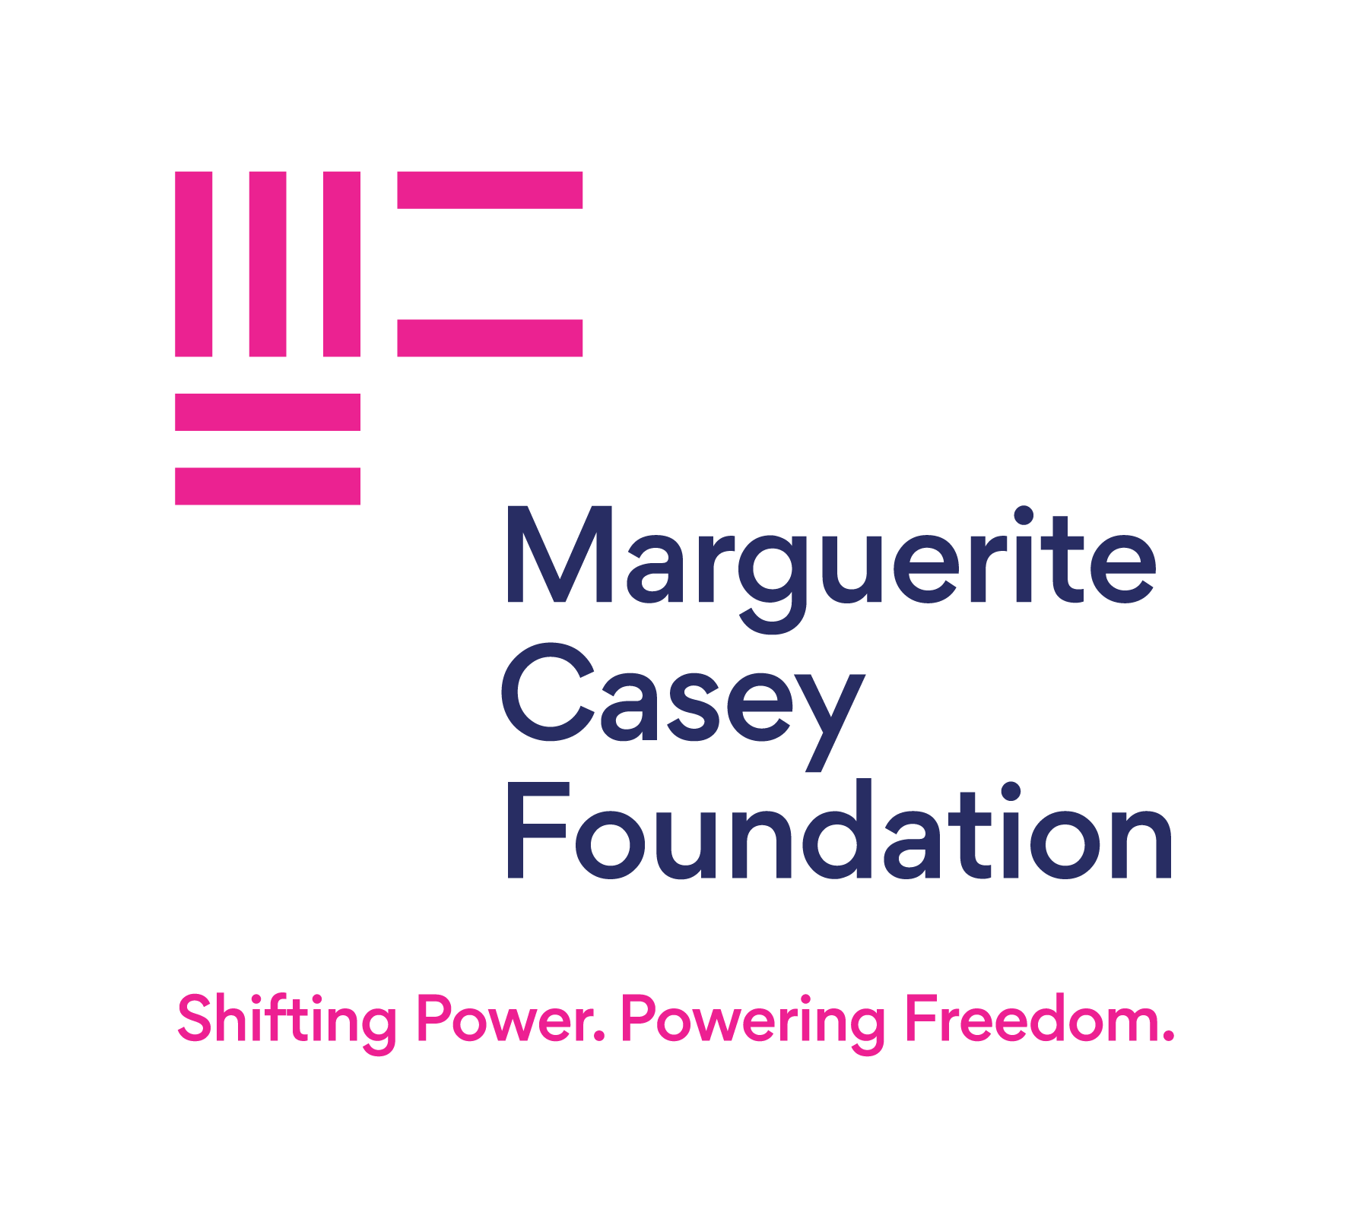
STATUS OF FOUNDATIONS
Exceptions!
Gates Foundation
Marguerite Casey Foundation
Simons Foundation
Notes:
Gates is spending down. $200 Billion over the next 20 years on four priority areas.
Marguerite Casey is an example of mission-centered choice to spend down endowment as a response to current events.
Simons is already distributing 8% annually, and they will continue to do that.

Slide 28
STATUS OF FOUNDATIONS
Preparing for the possible loss of 501(c)(3) status and/or endowment tax.
If so, they anticipate having less money available to distribute, but no other discernible change in operations.

Slide 29
STATUS OF FOUNDATIONS
More cross-organization collaboration
Pooled funds, co-administered RFPs
Example:
Spencer Foundation Rapid Response Bridge Funding Program
(Collaboration with Kapor Foundation, William T. Grant Foundation, and Alfred P. Sloan Foundation)

Slide 31
STATUS OF FOUNDATIONS
More competition
William T. Grant Foundation this month:
10x the number of attendees at an informational webinar.
4x the number of applicants to an RFP.
Prior to this year, WTG Foundation had a 4-5% success rate for applicants; that will likely drop.
Notes:
Similar stories were reported by all the private foundations we heard from.
They are staffing up for an influx of applicants, so many will be prepared to handle the increased traffic. There is not increased funding, though, so it just means that each of these foundations just became significantly more competitive.

Slide 32
CLOSING ADVICE

Slide 33
CLOSING ADVICE
Fit to a funder’s priorities is more important than ever. Don’t try to force your square peg applications into a round hole.
Speak to the funder’s mission and how a partnership with you advances their impact goals.

Slide 34
CLOSING ADVICE
Adam F. Falk, President of the Alfred P. Sloan Foundation:
“Read the funding announcement, read the foundation announcement, and then once again, read the funding announcement.”

Slide 35
CLOSING ADVICE
There is not enough philanthropic funding to fill the gap left by federal research funding loss.
Philanthropy continues to operate from a vantage point of filling gaps where government doesn’t operate.
Notes:
In 2023, federal R&D funding at universities was about $60 billion. The good news is that funding from private foundations increased in that year by 13.3%, which is huge. However, that increase still only brings the total amount of research support by private foundations to less than 10% of what federal agencies provide.
The government is not good at taking on high-risk research or untested innovation.
Partnerships that collaborate across societal silos are still uncommon in the public sector.
And the research that invests in the societal benefits of inclusivity, equity, and diversity is currently under siege.
While there are a lot of new gaps in government funding, the mission of foundations to work in these specific spaces continues.

Slide 36
CLOSING ADVICE
Private Foundations are asking us to consider the potential “whiteboard moment” we will have in three years’ time.
Use this time to prepare for action, to transition into what comes next. What new systems could we build from a relatively clean slate that improve on what we have lost?

Slide 37
SUMMARY
Be findable!
Hone your message
Reach out to the OSU Foundation for help
Speak to a funder’s mission
and…
READ THE FUNDING ANNOUNCEMENT
Notes:
Be findable!
Hone your message to what about your work is innovative, collaborative, remarkable, and impactful to society
Lean on the experts at the OSU Foundation to help with this
Keep the funder’s mission front and center,
And always read the funding announcement!

Slide 38
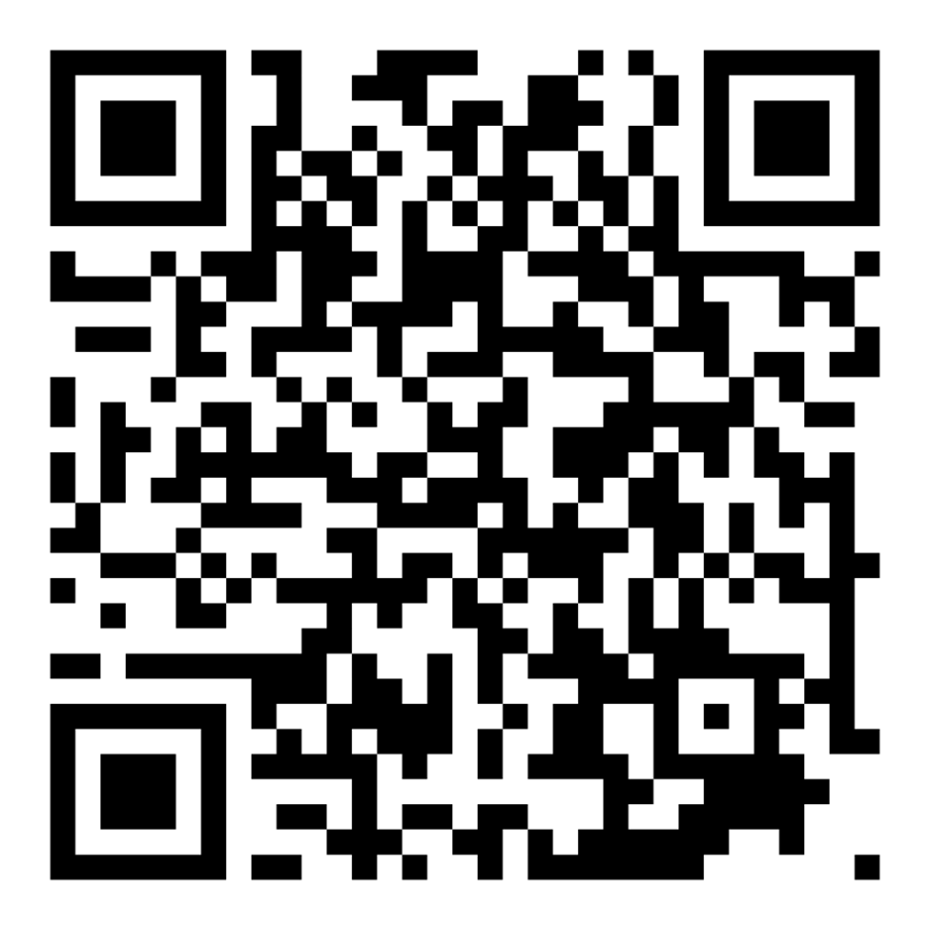
Contact us
www.fororegonstate.org/foundationrelations
Adeline Hull, Coordinator
Adeline.Hull@osufoundation.org
Contact me with your questions!

Slide 39
Questions?

