Slide 1
Office of foundation relations

Slide 2
OPEN DOOR
How to partner with OSU Foundation to find private funding opportunities that support research
Notes:
Elizabeth

Slide 3
OSU Foundation Office of Foundation Relations
Paul DuBois
Director
Emily Payne
Assistant Director
Adeline Hull
Coordinator
Elizabeth Ocampo
Director
Notes:
Vacant: Senior Director – let us know if you can recommend anyone!

Slide 4
Foundation Relations Services
The OSU Foundation Office of Foundation Relations is here to help get you funding.
Prospect research, vetting
Relationship development with private foundations
Proposal review, editing, and submission
Post-award report coordination and submission
Grant writing and proposal development training
Notes:
Aaron

Slide 5
Foundation Relations Services Prospect Research
We research prospective private foundations to ensure that the proposed private foundation is a good match for a particular project. We also help identify prospective funders for projects.
TOOLS:
RFP Newsletter www.fororegonstate.org/fundingopportunities
GrantForward https://guides.library.oregonstate.edu/grants
Notes:
Paul + Elizabeth on Grant Forward
Join us at 11 for a session built from reviewer feedback from prior grant submissions followed by Q&A over lunch.

Slide 6
Foundation Relations Services Relationship Management
We work with and engage individual foundations on behalf of OSU, including attending training, obtaining technical information, and providing stewardship.
Notes:
Emily

Slide 7
Foundation Relations Services Proposal Review, Editing, Submission
Proposal reviews are tailored to meet your needs. We provide reviews ranging from critiques of the written narrative to final proofreading.
When requesting a review, please contact the office at least six business days before the deadline. Reviews are provided on proposals requesting at least $10,000.
Notes:
Emily

Slide 8
Foundation Relations Services Post-Award Reporting
We track final reporting deadlines and coordinate with applicants on report submissions.
Notes:
Emily

Slide 9
Foundation Relations Services Grant Training and Skill Building
We provide training opportunities to build grant skills for university applicants. Includes:
Proposal development for private foundations
New faculty training
Grant training for academic units
Notes:
Elizabeth

Slide 10
ABOUT PRIVATE FOUNDATIONS
Notes:
Elizabeth

Slide 11
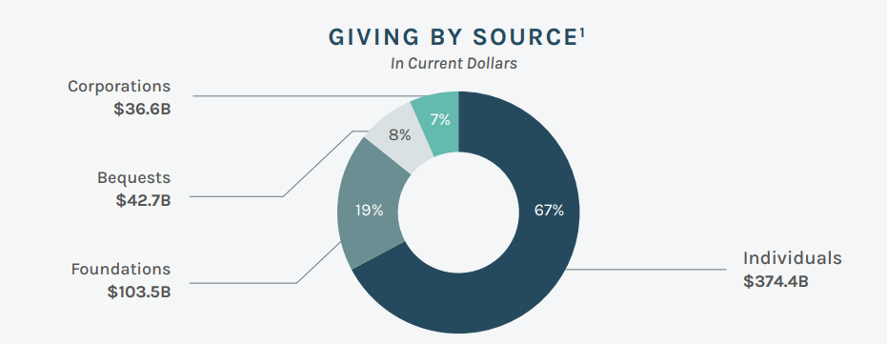
Philanthropic Giving in 2023
There are more than 120,000 foundations in the United States, each with its own processes and priorities.
Foundation giving surpassed
$100 billion for the second year
in a row.
https://www.ccsfundraising.com/insights/philanthropiclandscape/
Notes:
Elizabeth
Charts from the “2024 Snapshot of Today’s Philanthropic Landscape” report produced by CCS Fundraising. CCS is a strategic fundraising firm
that partners with nonprofits for transformational change.
Giving to foundations grew by an estimated 15.4% to $80 billion, an impressive growth even when adjusted for inflation (10.8%). From 2019 through 2023, giving to foundations reached its highest levels since Giving USA began tracking this data in 1978.

Slide 12
When you know one private foundation, you know …
one private foundation.
This slide includes a background graphic of many lightbulbs, but only one is illuminated.
Notes:
Aaron

Slide 13
About Private Foundations
Private funders can share some giving priorities with individual donors:
Legacy Foundations – trying to enact the philanthropic vision of someone from the past (e.g., Rockefeller, Carnegie, Hewlett)
Family Foundations – trying to enact the philanthropic vision of a family group (e.g., Wayne and Gladys Valley Foundation, W.M. Keck Foundation, Heising-Simons Foundation)
Corporate Foundations – trying to enact a philanthropic vision to curry social capital for the corporation (e.g., Intel Foundation)
Notes:
Elizabeth
Private funders often resemble individual donors more than federal funding agencies. They seek to enact the philanthropic vision of the people, families, or corporations that establish them. It’s best to remember private foundations come from a place of altruism, whereas the national science foundation, for example, comes from placing value on asking why and how for the sole benefit of knowing the answer. Because of this distinction, private and public funding agencies work on different problems to accomplish different goals.

Slide 14
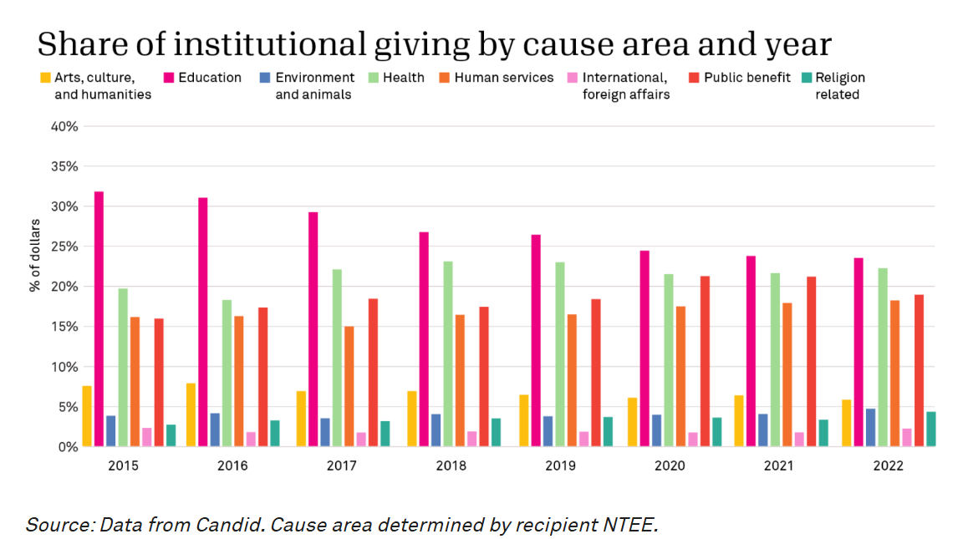
OSU
Notes:
Elizabeth
The share of institutional giving toward educational organizations, like OSU has been decreasing over the past seven years, replaced by increases in giving toward organizations serving public benefit, human services, and health causes. As of 2023, education sector giving continued to be the largest cause area, and higher education represents more than 50% of giving in this category.

Slide 15
DIFFERENCES BETWEEN PRIVATE AND PUBLIC GRANTS
Notes:
Elizabeth

Slide 16
Public and federal agency granting organizations require the same basic structures in grant proposals as private foundations, except…
Notes:
Aaron

Slide 17
KEY DIFFERENCES
STRATEGY
IMPACT
AUDIENCE
Notes:
Elizabeth

Slide 18
Key Difference #1: STRATEGY
Not all projects are ideal for private foundations. Instead, their STRATEGY (generally!) is to fund areas that public agencies do not address.
Notes:
Elizabeth

Slide 19
STRATEGY
Many private foundations are motivated to support interdisciplinary or intersectoral projects.
They want to tackle seemingly insurmountable challenges through partnerships among academic, government, corporate, and/or direct-service nonprofit organizations.
Notes:
Elizabeth

Slide 20
Key Difference #2: IMPACT
Many private foundations prioritize the proposed work’s IMPACT, or, in other words, the measures of its societal benefit.
The impact of your project answers the question, “so what?”
Notes:
Aaron

Slide 21
Key Difference #3: AUDIENCE
The AUDIENCE for a private foundation proposal frequently differs from that of public agency.
Notes:
Emily

Slide 22
AUDIENCE
For this reason, your proposal’s language should avoid jargon, use concise language, and be accessible to an audience beyond your peers.
Notes:
Emily

Slide 23
WORKING WITH OSU FOUNDATION
OSU Foundation can help you modify your grant proposals with these key differences in mind.
We can also help you navigate the internal logistics of grant submissions.
Notes:
Emily

Slide 24
WHERE TO FIND PRIVATE GRANT FUNDING OPPORTUNITIES
Notes:
Elizabeth

Slide 25
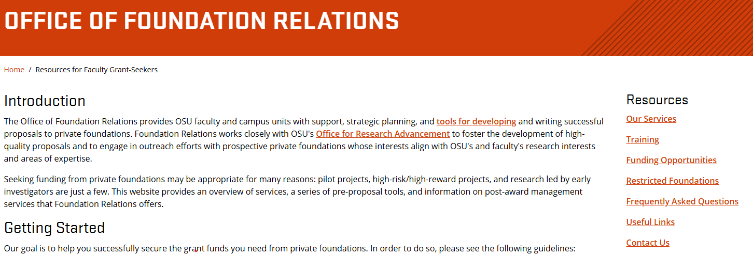
FOUNDATION RELATIONS WEBSITE www.fororegonstate.org/foundationrelations

Slide 26
RFP Newsletter
https://fororegonstate.org/fundingopportunities
The OSU Foundation’s RFP newsletter is the most comprehensive listing of the open funding opportunities we are monitoring at any given time.
Four tabs at the bottom:
New Opportunities
Rolling Deadlines
Previous Announcements
Contact Info
TIP: Use Ctrl + F to search the whole spreadsheet for keywords

Slide 27
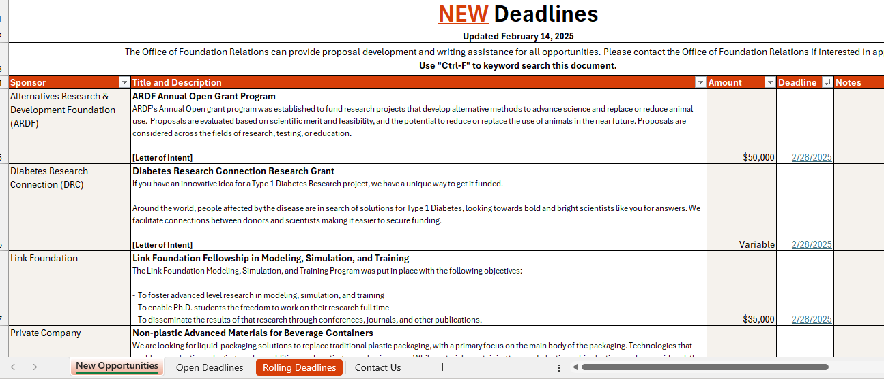
Current RFP Newsletter

Slide 28
GrantForward
https://guides.library.oregonstate.edu/grants
A subscription database that allows users to search for both federal and private funding opportunities. Sort by category, sponsor type, deadline, and more.
Use advanced search terms, save searches, and subscribe to receive automated notifications.

Slide 29
Philanthropy News Digest
http://philanthropynewsdigest.org/
Philanthropy News Digest (PND) is a daily news service and compendium, in digest form, of philanthropy-related articles and features culled from print and electronic media outlets nationwide.
Daily RFP published listings. Subscribe!

Slide 30
Cooperative Approach
The Foundation Relations Team uses our tools to scour the internet for funding opportunities twice monthly. In addition, we monitor a portfolio of funders for funding developments.
You use the available search tools, like individualized searches with GrantForward, PND, and LinkedIn.
Through our joint efforts, we are more likely to see all the most relevant funding opportunities for your topic.

Slide 31
Playing Matchmaker
The Foundation Relations team works to match funding opportunities with OSU faculty and programs.
You can help!
Share your research topic/project idea and vision with the OSUF team.
What problem does your work hope to solve?
What method do you plan to use?
Who does your work benefit? Be specific!
How is society improved through your efforts? What is the impact?
Notes:
Reach out to any one of us to discuss your project. We are always interested in hearing about your work and what you are looking for. Send us an email, ask for a zoom call, whatever works best for you. We here to help!

Slide 32
DISCERNING WHICH OPPORTUNITIES ARE WORTH PURSUING
Notes:
Elizabeth

Slide 33
IMPACT
Can I partner with this funder to achieve shared impact goals and mission?
Will my project achieve the outcomes the funder prioritizes?
Does my work benefit the population (demographic, geographic) the funder wishes to serve?
Notes:
Aaron

Slide 34
ELIGIBILITY
Is the university an eligible applicant? If not, is OSU Foundation an eligible applicant?
Is my rank or position eligible for the grant call?
Is my discipline, research focus, or methodology supported by the grant call?
Is this a limited submission or restricted opportunity?
Notes:
Elizabeth

Slide 35
PAST FUNDING HISTORY
Does this funder have a history of funding
Institutions like OSU? (Universities generally, peer universities, universities in my geographic region)
Does this funder have a history of funding projects like mine? (Project type, scope, scale)
Notes:
Emily

Slide 36
TIMELINE AND BUDGET
Will funding be available when you are going to need it?
Is the submission deadline achievable?
Is the award amount compatible with your budget needs? (Consider the indirect costs and other use restrictions)
Notes:
Emily

Slide 37
COMPETITIVENESS AND SUCCESS RATE
How competitive is the grant? Is your idea novel?
What is the average success rate, and do you have a chance of securing funding?
Notes:
Emily

Slide 38
PRIVATE GRANTS AS PART OF A COMPRENSIVE FUNDING PLAN
Notes:
Elizabeth

Slide 39
SUMMARY
Private foundations can be a valuable tool in your comprehensive funding plan.
They are not for everything, but they can move a project or research in new or innovative directions.
Notes:
Aaron

Slide 40
COMMON STRATEGIES
Private foundation partners want to help you:
get a project off the ground, so it can be self-sustaining;
achieve discrete outcomes that meet one of the funder’s philanthropic goals; and/or
secure preliminary data to support a larger proposal to a public agency.

Slide 41
Contact us
www.fororegonstate.org/foundationrelations
Paul DuBois, Director
Paul.DuBois@osufoundation.org
Adeline Hull, Coordinator
Adeline.Hull@osufoundation.org
Contact me with your questions!
Elizabeth Ocampo, Director
Elizabeth.Ocampo@osufoundation.org
Emily Payne, Assistant Director
Emily.Payne@osufoundation.org
Notes:
Addie
If you want to contact us, feel free to reach out to anyone on our team. Our coordinator, Adeline Hull, is a great resource if you’re not sure whom to contact – she can get your question or request to the right person on our team!

Slide 42
Questions?

